Slide 1

Wellness Clinic Medical Group
SHANSHAN DU, YIXUAN LIANG, JIAJIA DING
APRIL 15, 2023

Slide 2
Scenario
The Wellness Clinic Medical Group is a healthcare facility located in a rural area that provides medical care to several thousand patients.
Its professional staff includes physicians,nurse-practitioners, registered nurses, midwives, a pharmacist, and a medical technician.
The clinic operates during regular hours and provides emergency coverage 24/7. Patients can schedule appointments or visit during unscheduled hours for acute or chronic illness treatment.
The clinic provides care for all patients regardless of their ability to pay and bills are generated based on services provided.

Slide 3
Building a Database for Wellness Clinic Medical Group
Problem statement and approach. 1. Problem: Currently, Patient information and treatment conditions are written by hand, which prevents them from serving patients better.
2.Solution: Keeps track of all the patient-related activities of the clinic and to provide information about billing and payments.

Slide 4
Generally, creating a database roughly requires the following steps
identifying needs
building a data dictionary
ERD
review request
tables relationship
EERD

Slide 5
Step 1 - Identify Needs
Description: Collecting forms and reports from Wellness Clinic Medical Group to understand their operational process and identify their needs.
Forms and Reports

Slide 6
Step 2 - Build Data Dictionary
Description: Creating a data dictionary based on the data attributes from the forms and reports collected. Includes data attributes, data definition, data type, data length, and examples for specific data attributes. Open the link to view the specific data dictionary: Data Dictionary

Slide 7
Step 3 - Build Entity Relationship Diagram (ERD)
Description: Creating an ERD to identify major entities (strong entities and weak entities), such as Patient, Staff, Appointment, and Facilities. Adding attributes to entities and defining their relationships using cardinality.(many- to-many, many-to-one, one-to-one,one-to-many)

Slide 8
Step 4 - Build Extended Entity Relationship Diagram (EERD)
Description: Creating a more comprehensive EERD by making assumptions about entities' relationships.
Incorporating additional attributes and relationships.

Slide 9
Step 5 - Create Database and Tables
Description: Initiating the database by creating tables based on the entities and attributes defined in the EERD. Adding column data types, data lengths, and constraints (e.g., NOT NULL, CHECK, UNIQUE) for data security. Adding PRIMARY KEY and FOREIGN KEY constraints to define relationships between tables using ALTER TABLE statements. Inserting records into the tables using INSERT INTO statements.

Slide 10
Step 6 - Verify Against Requirements
Description: Reviewing the requirements of Wellness Clinic Medical Group. Comparing data attributes from the data dictionary against the manual forms and reports. Validating the columns of the database and tables against the entities, attributes, relationships, and cardinality from the EERD.

Slide 11
ER-Diagram
Appointment Procedure
Test Procedure
Prescription Procedure
Medicine Procedure
Operation Procedure
Recovery and Delivery Procedure
Bill and Payment Procedure

Slide 12
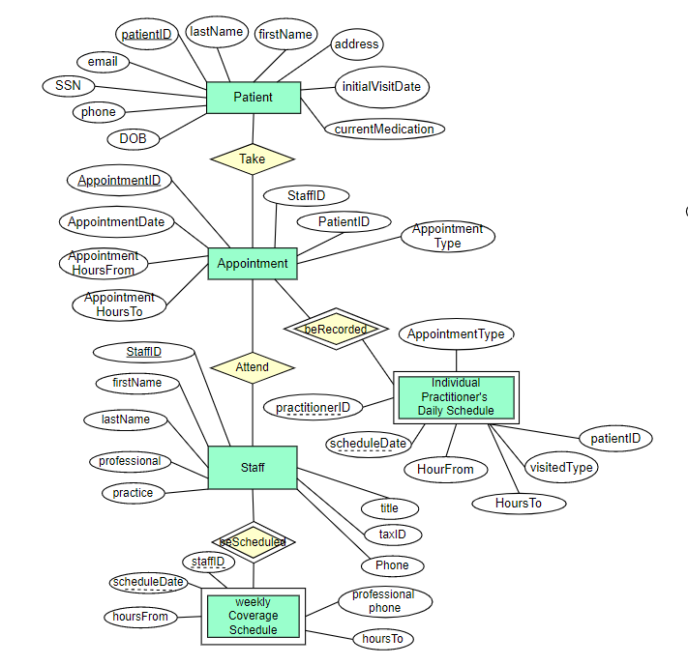
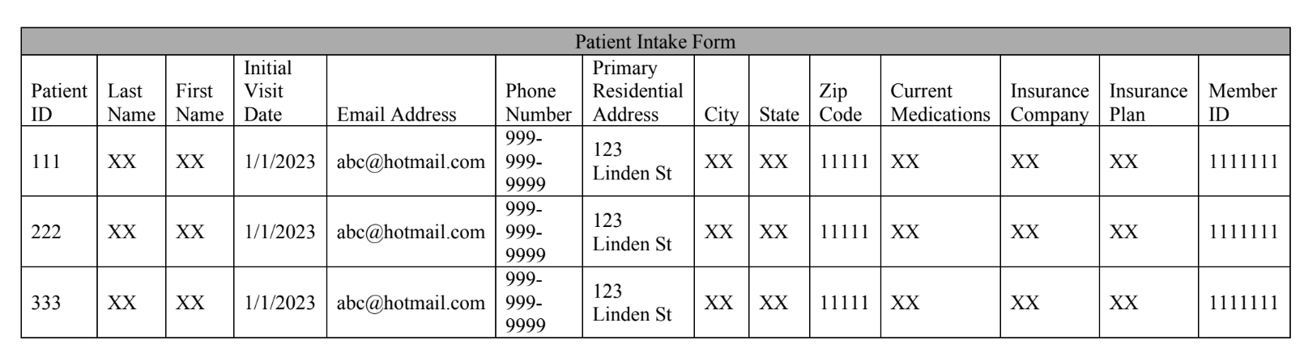
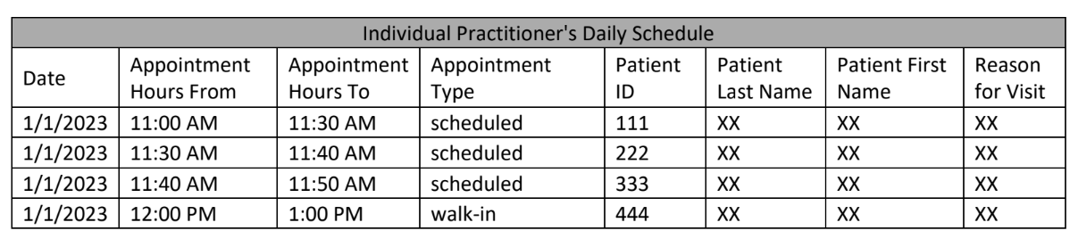
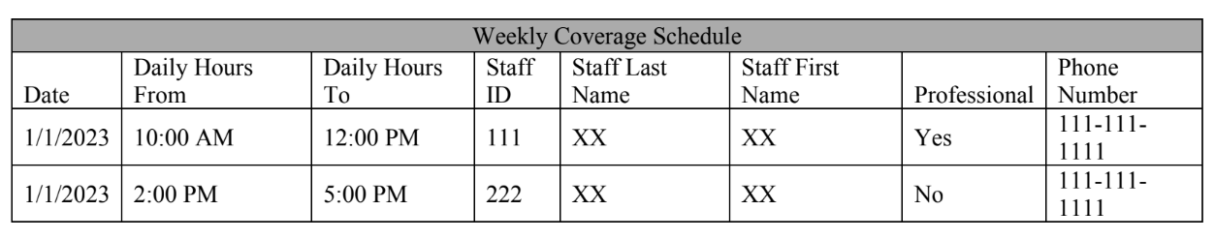
Appointment Procedure
Cardinality:
Patient – Appointment: 1: M
Staff – Appointment: 1:M

Slide 13
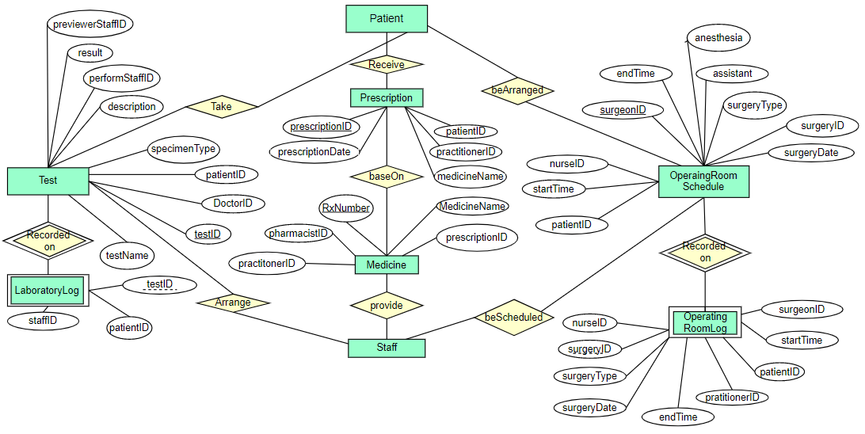
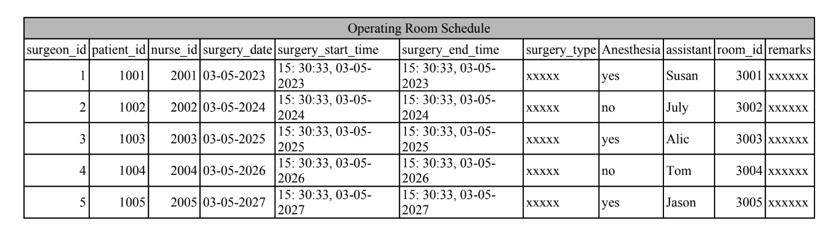
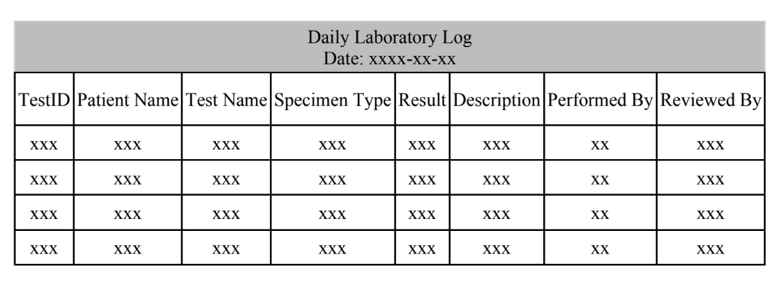
Test, Prescription, Medicine, and Operation
Prescription Label and Receipt
Prescription Label Rx Number: ________ Doctor Name: ________ Patient Name: ________ Patient Address: ________ Directions: ________ Drug Name: ______ Form: ________ Strength: _______ Quantity: ______ Pharmacist's Name: _______Date Filled: ________ Original Date: _______ Refills Remaining: ________ -------------------------------------------------------------------------------------------- Prescription Receipt Rx Number: ________ Doctor Name: ________ Patient Name: ________ Patient Address: ________ Directions: ________ Drug Name: ______ Form: ________ Strength: _______ Quantity: ______ Pharmacist's Name: ______Date Filled: ________ Original Date: _______ Refills Remaining: ________ Total Price: ________ Amount Covered by Insurance/Government: ________ Balance Due from Patient: _______________________ Drug Information: Directions for Use: Warnings:
Patient – Test: 1: M
Patient – Prescription: 1:M
Patient – OperatingRoomSchedule: 1: M
Prescription – Medicine: 1:M
Staff – Test: 1: M
Staff – Medicine: 1:M
Staff – OperatingRoomSchedule: M: M

Slide 14
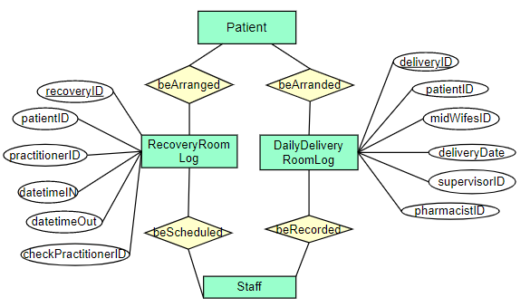
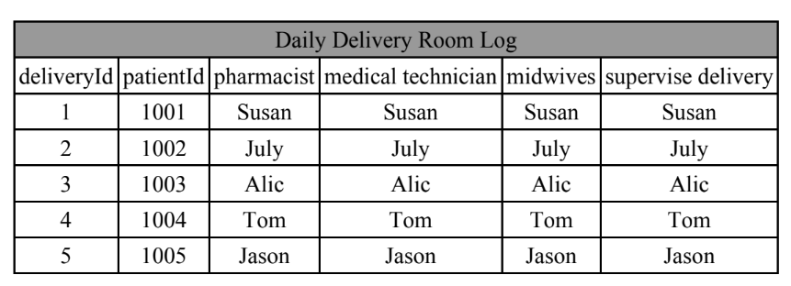
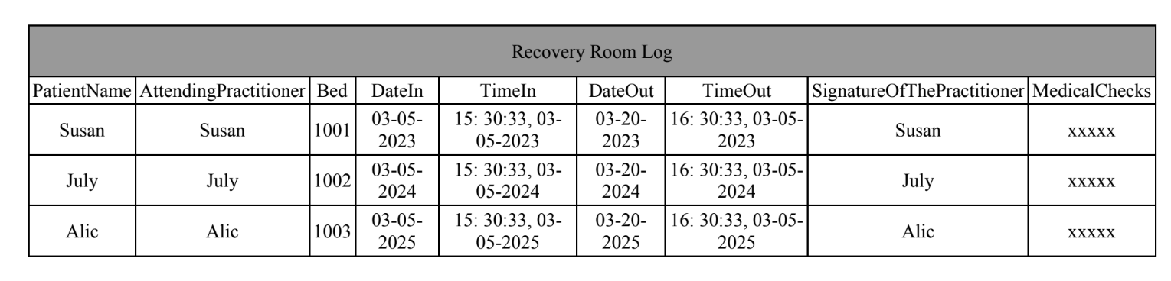
Recovery and Delivery
Patient – RecoveryRoomLog: 1: M
Patient – DailyDeliveryRoomLog: 1:M
Staff – RecoveryRoomLog: M: M
Staff – DailyDeliveryRoomLog: M:M

Slide 15
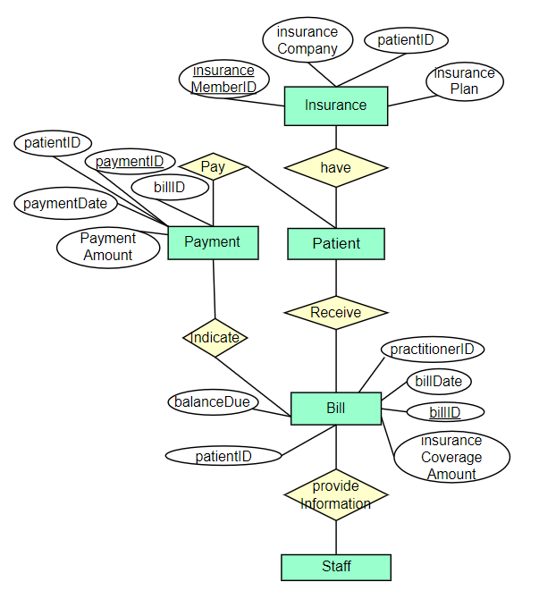
Payment Procedure
Patient – Insurance: 1: 1
Patient – Payment: 1:M
Patient – Bill: 1: M
Staff – Bill: M: M
Bill – Payment: M:M
Provider’s Statement for Insurance Forms
Information of Clinic Clinic Name: ______________________ Street ________________________ City __________ State _________ Zip _________ Telephone: Area Code _____ Number _____________________ Practitioners on Staff ⬜ Medical Doctor1 XXX Tax ID Number : XXXXXXXXXXXXXXX ⬜ Medical Doctor2 XXX Tax ID Number : XXXXXXXXXXXXXXX ⬜ Medical Doctor3 XXX Tax ID Number : XXXXXXXXXXXXXXX …… Visit Type □ Checkups □ Immunizations □ Chronic illness □ Acute illness □ Pre-care □ Post-care □ Emergency call □Other:______ Procedures Performed Procedure Code Fee □ Perform medical routines or tests XXX ______________ □ Take samples XXX ______________ □ Prescriptions XXX _______________ □ Laboratory tests(inside) XXX _______________ □ Laboratory tests(outside) XXX ________________ □ Pre-hospital care XXX ________________ □ Post-hospital care XXX _______________ □ Other: _________ ________________ Diagnosis Diagnosis Code □ Upper respiratory infections XXX □ Hypertension XXX □ Diabetes XXX □ Minor injuries XXX □ Other: ________________ ________________ Total Charge: ___________________ Amount Paid: ___________________ Balance Due: ____________________
Patient Monthly Statement
Dear [Patient Name], We are pleased to provide you with your Patient Monthly Statement for [Month, Year]. Services Provided: [Date of Service] [Service Description] $[Amount] [Date of Service] [Service Description] $[Amount] Payments Received: [Date of Payment] [Payment Description] $[Amount] Balance Due: Total Services Provided: $[Total Amount] Total Payments Received: $[Total Payment] Balance Due: $[Balance Due] Please remit payment in the amount of [Balance Due] by [Due Date] to avoid any further collection efforts. If you have any questions about your statement, please do not hesitate to contact us. Sincerely, [Wellness Clinic]

Slide 16
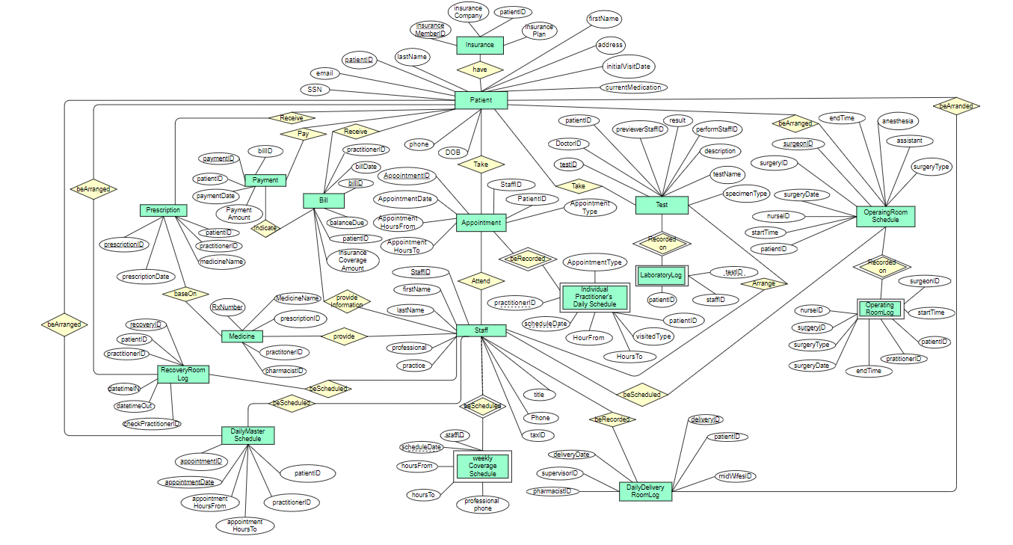
EER to Relational Schema
Patient, Staff
Appointment, Insurance, Bill, Payment, Prescription, Medicine, Test, Operating Room Schedule, Daily Master Schedule, Recovery Room Log, Daily Delivery Room Log
Operating Room Log, Laboratory Log, Individual Practitioner’s Daily Schedule, Weekly Coverage Schedule

Slide 17
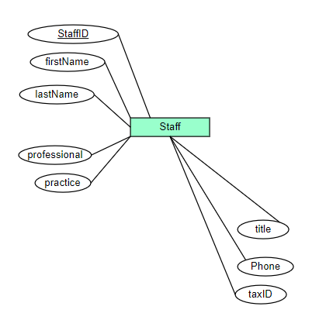
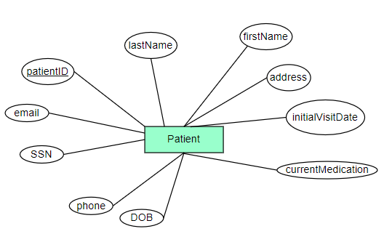
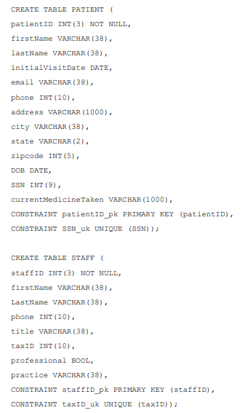
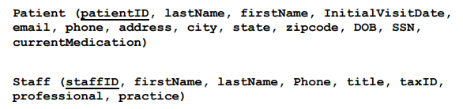
Schema

Slide 18
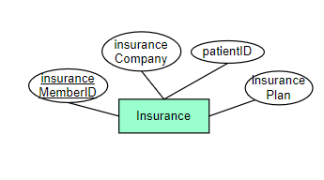
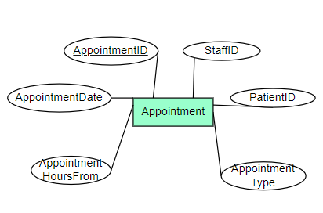
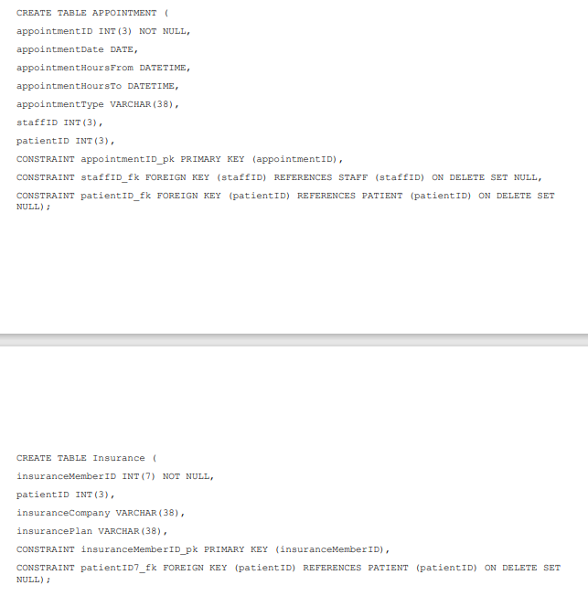
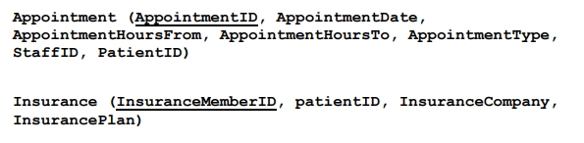
Schema

Slide 19
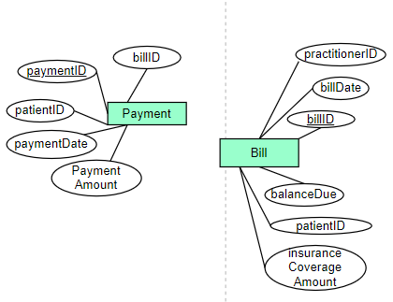
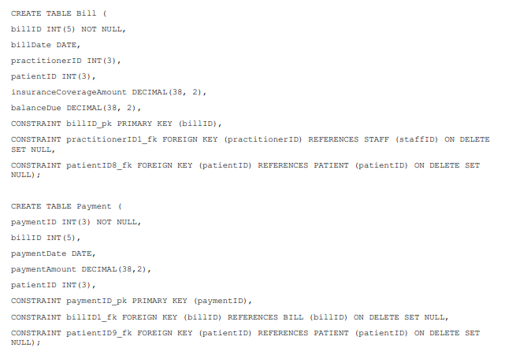
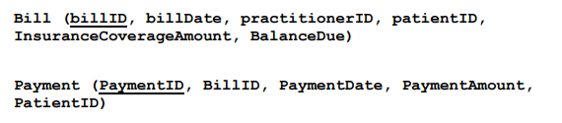
Schema

Slide 20
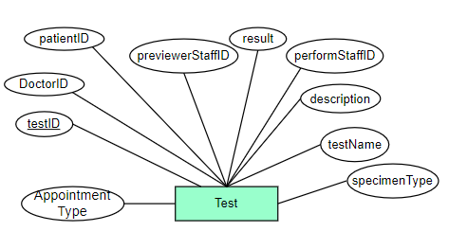
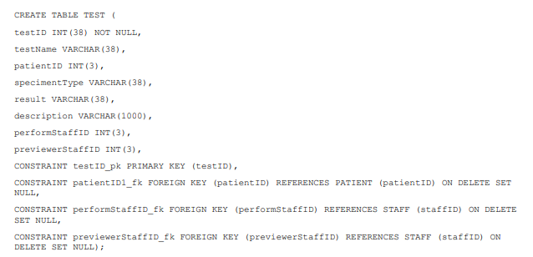
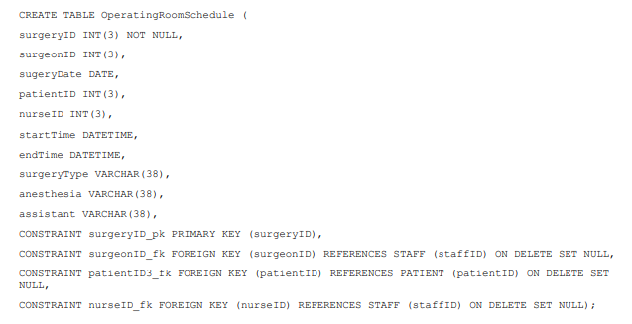
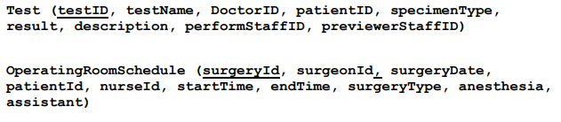
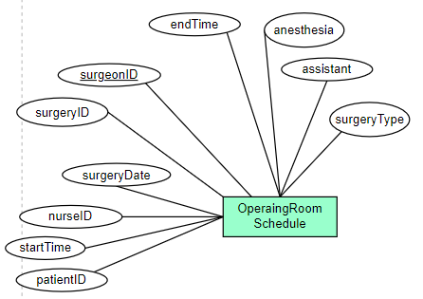
Schema

Slide 21
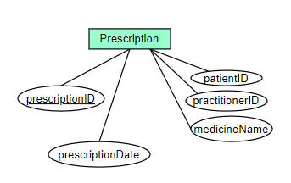
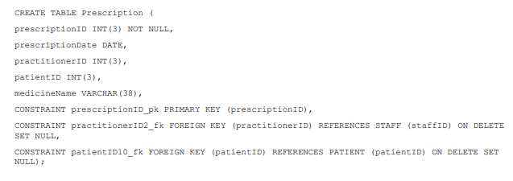
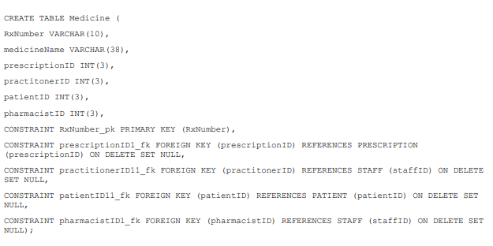
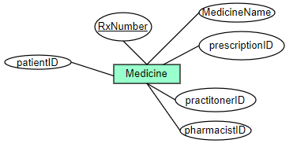
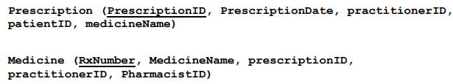
Schema

Slide 22
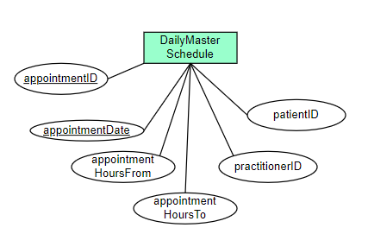
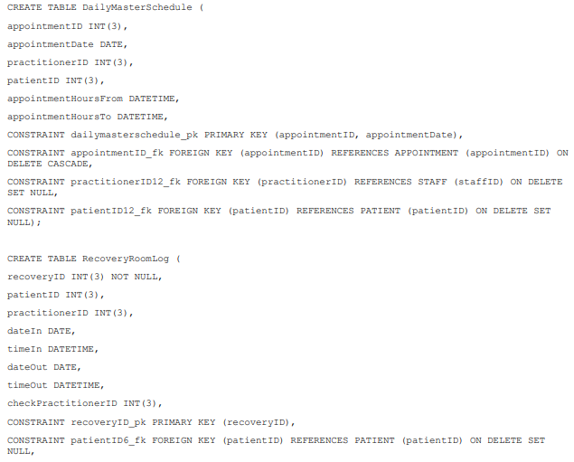
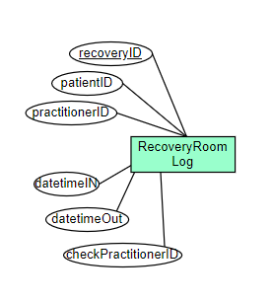
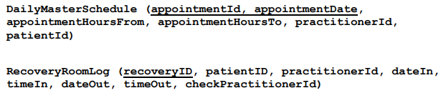
Schema

Slide 23
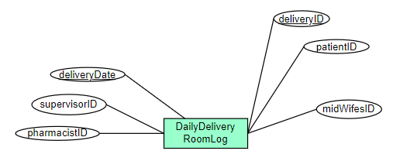

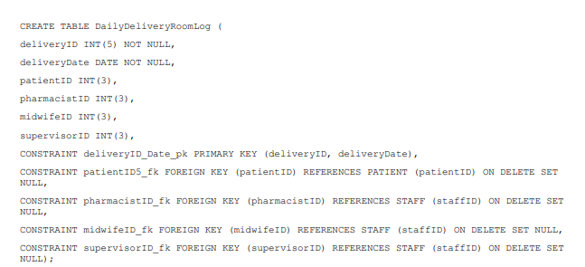
Schema

Slide 24
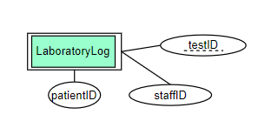
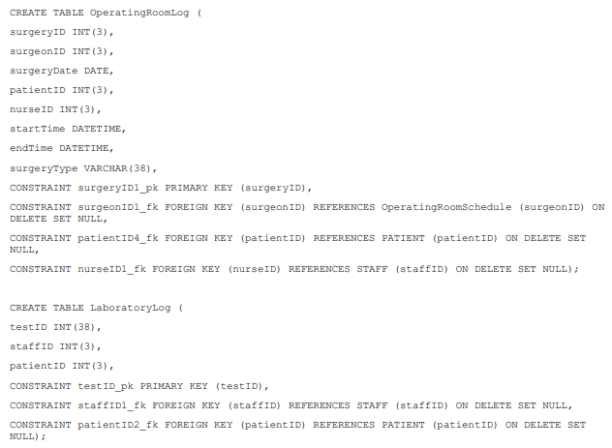
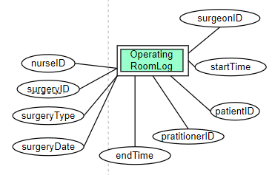
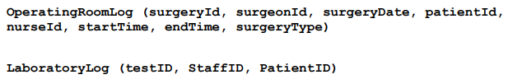
Schema

Slide 25
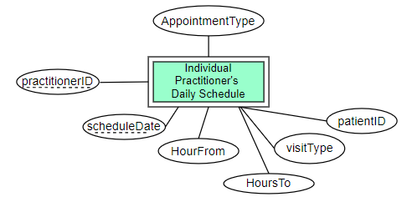
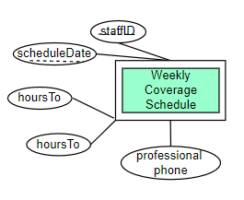
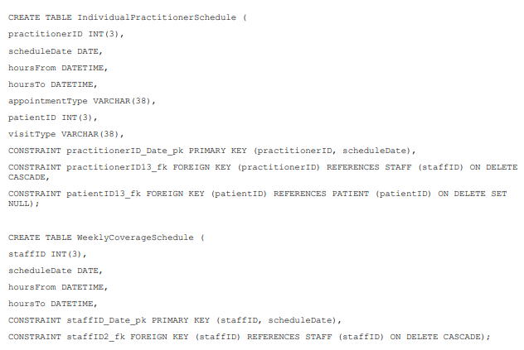
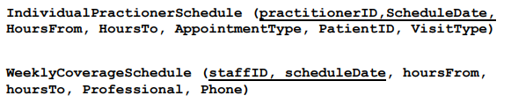
Schema

Slide 26
INSERT, JOINS
Retrieve the appointment details of a particular patient with patient ID 1:
SELECT * FROM APPOINTMENT WHERE patientID = 1;
Retrieve the list of patients who have undergone surgery:
SELECT DISTINCT P.firstName, P.lastName
FROM PATIENT P JOIN OperatingRoomSchedule OS
ON P.patientID = OS.patientID;
Retrieve the list of staff members who have performed a test on a particular patient with patient ID 2:
SELECT S.firstName, S.LastNameFROM STAFF S
JOIN TEST T ON S.staffID = T.performStaffID
WHERE T.patientID = 2;
Retrieve the list of patients who have not undergone any surgery
SELECT P.firstName, P.lastName
FROM PATIENT P
LEFT JOIN OperatingRoomSchedule OS ON P.patientID = OS.patientID
WHERE OS.surgeryID IS NULL;
Retrieve the total number of appointments for each staff member:
SELECT S.staffID, S.firstName, S.LastName, COUNT(*) ASappointment_count
FROM STAFF S
JOIN APPOINTMENT A ON S.staffID = A.staffID
GROUP BY S.staffID, S.firstName, S.LastName;

Slide 27
Challenge
Design:
identifying and prioritizing the most important information needed for the clinic's operations and designing a comprehensive database that contains all the necessary information.
Implement:
Difficulty in organizing entity relationships and creating non-overlapping ER diagrams.
Ensuring that the database is normalized to an appropriate level without over-normalizing or under-normalizing the data.
Usage:
Ensuring that the database is user-friendly and accessible to its intended users, while also maintaining data security and integrity.

Slide 28

Career Skills
Database Design : Draw ER diagram, Design schema table relationships
Database Design : Draw ER diagram, Design schema table relationships
coding: SQL language

Slide 29
Conclusion
Through this database project, we have gained valuable experience in database design and implementation, project management, teamwork, and problem-solving, which will be beneficial for our future learning and career development.
Looking forward, we will continue to refine and optimize the project and apply it to real-world business scenarios, aiming to achieve even better results in future database projects.

Slide 30
Thank you!
Q & A

